Slide 1

By:
Umair Azfar Khan

Slide 2
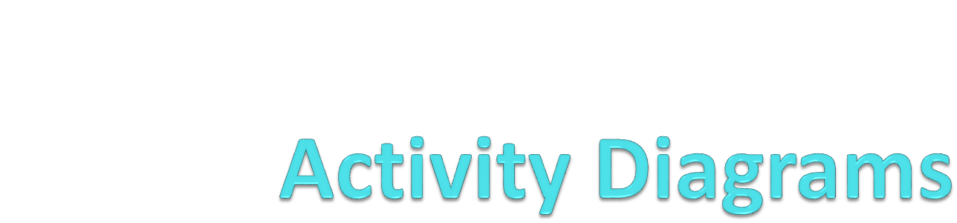
Lecture 03

Slide 3
Activity Diagrams
Activity diagrams show high-level actions chained together to represent a process occurring in your system.
For example, you can use an activity diagram to model the steps involved with creating a blog account.

Slide 4
Activity Diagrams
Activity diagrams are the only UML diagram in the process view of your system's model.
Activity diagrams are one of the most accessible UML diagrams since they use symbols similar to the widely-known flowchart notation

Slide 5
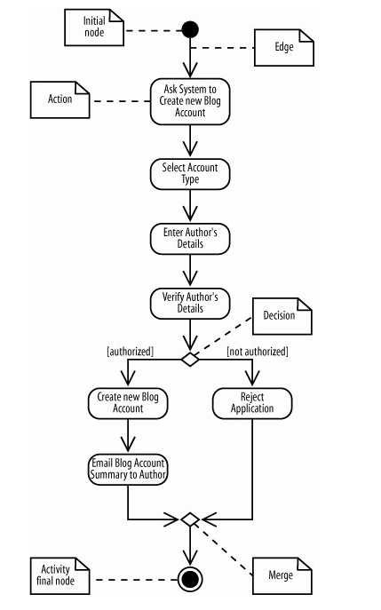

Slide 6
Activity Diagram Notations
The activity is launched by the initial node , which is drawn as a filled circle
The activity final node, drawn as two concentric circles with a filled inner circle, marks the end of the activity

Slide 7
Activity Diagram Notations
In between the initial node and the activity final node are actions , which are drawn as rounded rectangles
The flow of the activity is shown using arrowed lines called edges or paths
A line going into a node is called an incoming edge
A line exiting a node is called an outgoing edge
The first diamond-shaped node is called a decision
The second diamond-shaped node is called a merge

Slide 8
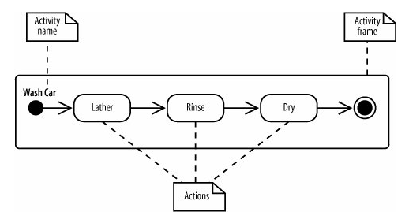
Activity and Actions
Activity is the process that is being modeled
Action is a step, or a process that happens in that activity

Slide 9
The activity is surrounded by a rounded rectangle which is called an activity frame
The name of the activity is written on the top left corner
The activity is “Wash Car” while Lather, Rinse and Dry are actions
Activity frame is optional, however if you remove the frame, you do not need to label the activity

Slide 10
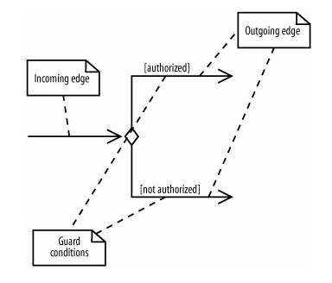
Decisions & Merges
Decisions are used when you want to execute a different sequence of actions depending on a condition.
Decisions are drawn as diamond-shaped nodes with one incoming edge and multiple outgoing edges.

Slide 11
Decisions & Merges
Each branched edge contains a guard condition written in brackets.
Guard conditions determine which edge is taken after a decision node..

Slide 12
Decisions & Merges
The branched flows join together at a merge node, which marks the end of the conditional behavior started at the decision node.
Merges are also shown with diamond-shaped nodes, but they have multiple incoming edges and one outgoing edge, as shown

Slide 13
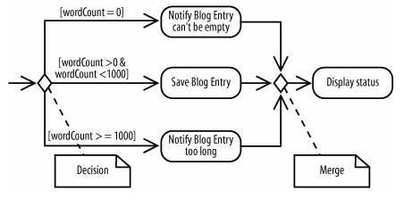
Decisions & Merges

Slide 14
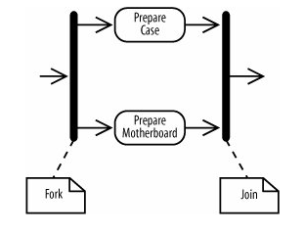
Forks & Joins
You represent parallel actions in activity diagrams by using forks and joins
They are used in paths where parallel activity takes place unlike in the decision nodes

Slide 15

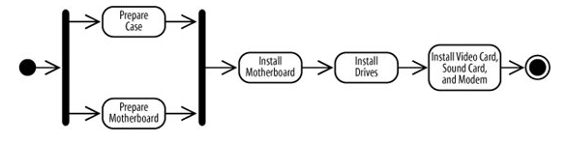
Example: Computer Assembly Workflow

Slide 16


Time Events
Time events are drawn with an hourglass symbol which represent a timed activity
The incoming edge to the time event means that the time event is activated once
A time event with no incoming flows is a recurring time event, meaning it's activated with the frequency in the text next to the hourglass.
a time event is an alternate way to model an activity that is launched periodically.

Slide 17
Calling other activities
As detail is added to your activity diagram if the diagram is too big, or the same sequence of actions may occur more than once.
When this happens, you can improve readability by providing details of an action in a separate diagram, allowing the higher level diagram to remain less cluttered.
An upside-down pitchfork symbol is used to indicate that a certain action is actually a call activity node.

Slide 18
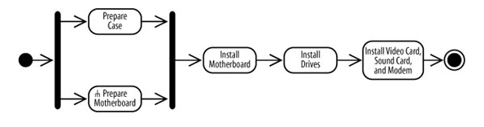
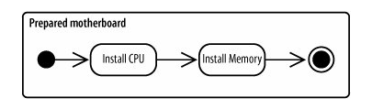

Slide 19
Exercise
Creating a character in a game is a long arduous process before it is used as game content. It is a combination of activities that take place between the concept artist, the 2D artist, the 3D modeler and finally the game programmer. The steps are as following:
The concept artist and the game programmer start working from the basic concept
The artist draws many sketches which are evaluated by the design team. These sketches may be rejected in which case they are re-made.
If the sketches are accepted, the 2D artist starts to draw textures that will be used by them

Slide 20
Exercise
The concept artist and the game programmer start working from the basic concept
The artist draws many sketches which are evaluated by the design team. These sketches may be rejected in which case they are re-made.
If the sketches are accepted, the 2D artist starts to draw textures that will be used by them
The textures are created from tools like photoshop and through pictures
The concept art is also used by the 3D modeler for creating the character in 3D
Once the textures and the 3D models are complete, the programmer imports them into his code

Slide 21
Objects
you can use object nodes to show data flowing through an activity.
An object node represents an object that is available at a particular point in the activity, and can be used to show that the object is used, created, or modified by any of its surrounding actions.
An object node is drawn with a rectangle

Slide 22
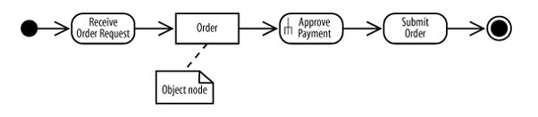
Objects

Slide 23
Pins
Pins show a different perspective of the object input or output
An input pin means that the specified object is input to an action.
An output pin means that the specified object is output from an action
Pins are good at emphasizing that an object is required input and output, whereas an object node simply means that the object is available at that particular point in the activity.

Slide 24
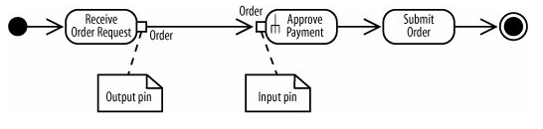
Pins

Slide 25
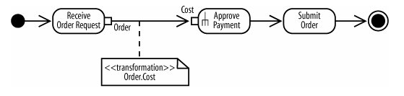
Transformations
When using an object you can use a transformation to show which parts are needed.
Transformations allow you to show how the output from one action provides the input to another action

Slide 26

Showing how objects change state
You can also show an object changing state as it flows through an activity

Slide 27
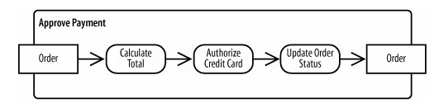
Showing input and output from an activity
Object nodes can be inputs to and outputs from an activity.
Activity inputs and outputs are drawn as object nodes straddling the boundary of the activity frame.
This notation is useful for emphasizing that the entire activity requires input and provides output.

Slide 28
Sending and Receiving Signals
Activities may involve interactions with external people, systems, or processes.
For example, when authorizing a credit card payment, you need to verify the card by interacting with an approval service provided by the credit card company.
In activity diagrams, signals represent interactions with external participants.

Slide 29
Sending and Receiving Signals
A receive signal has the effect of waking up an action in your activity diagram. The recipient of the signal knows how to react to the signal and expects that a signal will arrive at some time but doesn't know exactly when.
Send signals are signals sent to an external participant. When that external person or system receives the message, it probably does something in response, but that isn't modeled in your activity diagram

Slide 30
Sending and Receiving Signals
A send signal node sends signals asynchronously, meaning the activity does not wait for the response but moves immediately to the next action after the signal is sent.
The receive signal node shows that a signal is received from an external process.
At a receive signal node, the action waits until a signal is received and proceeds only when a signal is received.

Slide 31
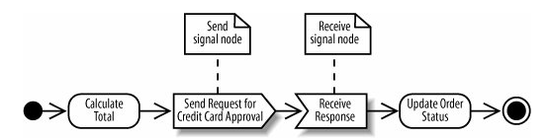

A receive signal node with no incoming flows means that the node is always waiting for a signal when its containing activity is active.

Slide 32
Starting an Activity
The activity starts by receiving input data, shown previously in "Showing Input to and Output from an Activity."
The activity starts in response to a time event, shown previously in "Time Events."
The activity starts as a result of being woken up by a signal.

Slide 33
Ending Activities
Sometimes you need to model that a process can be terminated by an event. This could happen if you have a long running process that can be interrupted by the user.
You draw an interruption region with a dashed, rounded rectangle surrounding the actions that can be interrupted along with the event that can cause the interruption.
The interrupting event is followed by a line that looks like a lightning bolt.

Slide 34
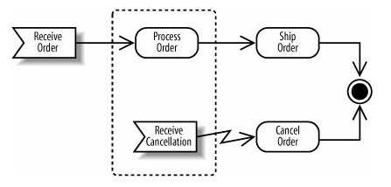
Interruption

Slide 35
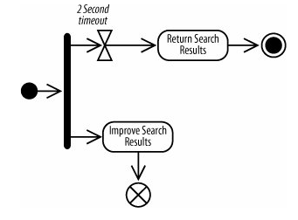
Ending a Flow
You can show that a flow dies without ending the whole activity.
A flow final node terminates its own path, not the whole activity.
It is shown as a circle with an X through it

